Slide 1

Continuous Integration
David E. Bernholdt Oak Ridge National Laboratory
Jared O’Neal Argonne National Laboratory
Mark C. Miller, Paul Bryant and the ECP CD/CI Team
Better Scientific Software Tutorial ECP 4th Annual Meeting, Houston, Texas
See slide 2 for license details
Notes:
Designed to be 15 Minute Talk + 20 minutes for the live Travis CI demo

Slide 2
License, Citation and Acknowledgements
License and Citation
This work is licensed under a Creative Commons Attribution 4.0 International License (CC BY 4.0).
The requested citation the overall tutorial is: David E. Bernholdt, Anshu Dubey, James M. Willenbring, Better Scientific Software tutorial, in Exascale Computing Project Fourth Annual Meeting, Houston, Texas. DOI: 10.6084/m9.figshare.11786868
Individual modules may be cited as Module Authors, Module Title, in Better Scientific Software Tutorial…
Acknowledgements
Alicia Klinvex
This work was supported by the U.S. Department of Energy Office of Science, Office of Advanced Scientific Computing Research (ASCR), and by the Exascale Computing Project (17-SC-20-SC), a collaborative effort of the U.S. Department of Energy Office of Science and the National Nuclear Security Administration.
This work was performed in part at the Oak Ridge National Laboratory, which is managed by UT-Battelle, LLC for the U.S. Department of Energy under Contract No. DE-AC05-00OR22725.
This work was performed in part at the Argonne National Laboratory, which is managed managed by UChicago Argonne, LLC for the U.S. Department of Energy under Contract No. DE-AC02-06CH11357.

Slide 3
The Short & Sweet of Continuous Integration
A master branch that always works
DVCS workflow isolate master from integration environment
Extend workflow to address difficulties of integrating
Minimize likelihood of merge conflict
Detect bugs immediately
Make debugging process quick and easy
Notes:
DVCS workflow is a step in the right direction, but is insufficient, for it does not necessarily impose rules that minimize the likelihood of merge conflicts. We also want to build into CI testing to make debugging quick and easy.

Slide 4
Work Decomposition
Commit and integrate often
Limit divergence between feature and master branches
Decreased probability of conflict
Conflict resolution is simpler and less risky

Slide 5
Error Detection
Test at integration to identify failures immediately
Control quality of code
Isolate failure to few commits
No context switching for programmer
We want a system that
triggers automated builds/tests on target environments when code changes and
ideally tests on proposed merge product without finalizing merge.

Slide 6
Test Servers
Servers that
automate the execution of a test suite or a subset of a test suite,
allow for running tests on different environments,
host an interface for viewing results, and
allows for configuring when the tests are run.
Examples
CTest/CDash
Jenkins
Travis CI and GitLab CI
Notes:
Emphasize that depending on services offered by service, the tests can be configured to commits/pull requests and by branch.
Also, would like to run some tests on a nightly basis. This is useful for large codes, where program execution could be prohibitive so that linking to commits would not be reasonable.
This where testing can be extended into continuous integration, which we will discuss later.

Slide 7
Cloud-based Test Servers
Linked to VCS hosts
GitHub & Travis CI
GitLab CI
BitBucket Pipelines
Automated builds/tests triggered via pushes and pull requests
Builds/tests can be run on cloud systems
Test results are reported in repository’s web interface
Can trigger code coverage analysis & documentation build
Notes:
No need to build and maintain a dedicated server.
Jenkins is another option. Not linked to any particular DVCS and can be built on dedicated server. Benefit is that you can often log into machine, setup and test your suite, and update/test new baselines when needed.

Slide 8
Continuous integration (CI) Summary
Has existed for some time and interest is growing
HPC community working to adapt CI for HPC machines
Setup, maintenance, and monitoring required
Prerequisites
A reasonably-automated build system
An automated test system with significant test coverage & useful feedback
Builds/tests must finish in reasonable about of time
Ability to bundle subset of tests

Slide 9
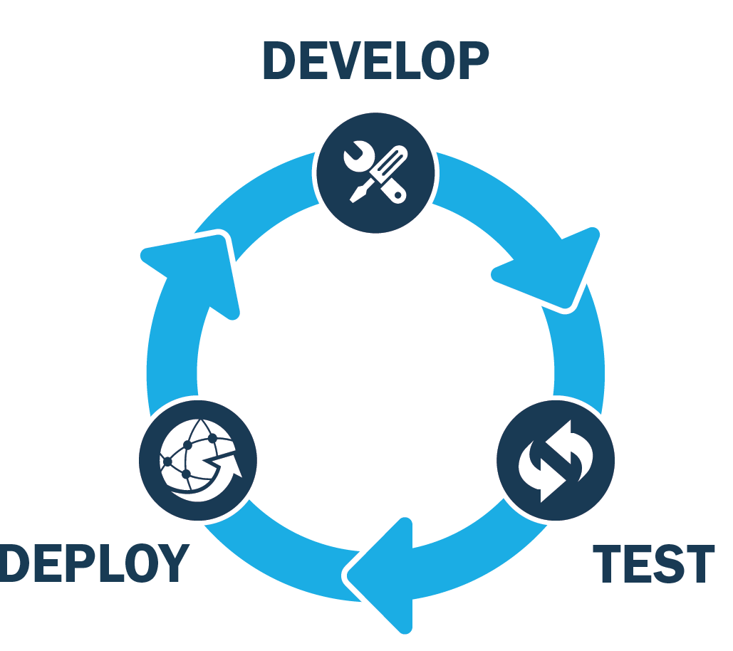
ECP Project: WBS 2.4.4
Software Deployment at Facilities - Software Integration
The Software Integration effort was established to bridge the ECP ST software development effort with the Exascale hardware and software environments deployed at the Facilities.
Continuous Integration (CI) - Provide the ability to continuously test AD/ST software on facility hardware resources with software environments established at the Facility.
Key for software development teams targeting systems being deployed agile feedback loop is key for development
Based on material provided by Mark C. Miller, Paul Bryant, and the ECP CD/CI Team

Slide 10
CI Solution for Large-Scale HPC Facilities
Need: HPC centers need new security features within Continuous Integration systems to serve thousands of users with unique hardware and security requirements.
Response: Using GitLab as a basis, extend security, permissions, and auditing features while improving intra-Lab and inter-Lab accessibility to CI pipelines.
Notes:
We are on path to support both

Slide 11
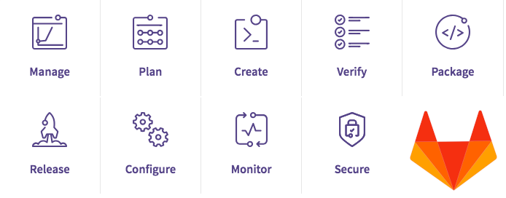
GitLab
GitLab is a single platform for the entire DevOps lifecycle
Plan, create, verify, and release
Core functionality (free)
Version control, collaboration, CI/CD, and documentation tools
Open source and capable of self management
MIT License
Additional tiers of functionality are only available via license
https://about.gitlab.com/pricing/self-managed/feature-comparison/
Source: https://docs.gitlab.com/ee/

Slide 12
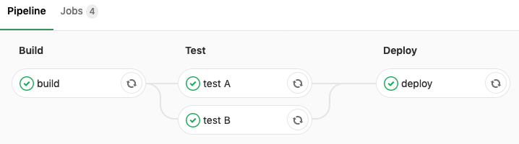
GitLab CI/CD
GitLab offers robust support for CI/CD (Continues Delivery)
Primarily controlled via a ‘.gitlab-ci.yml’ file defined in your project repository
Defines the jobs that will be run, their structure, and what will trigger their potential execution
https://docs.gitlab.com/ee/ci/yaml/
Terms:
Jobs: Core elements of CI, where commands are defined for execution
Stages: Defined order for job execution within a pipeline
Pipelines: Collection of jobs
Pipelines can be triggered through a number of mechanisms, including: commits, manually, api, scheduling, merge requests, upstream projects, and more...

Slide 13
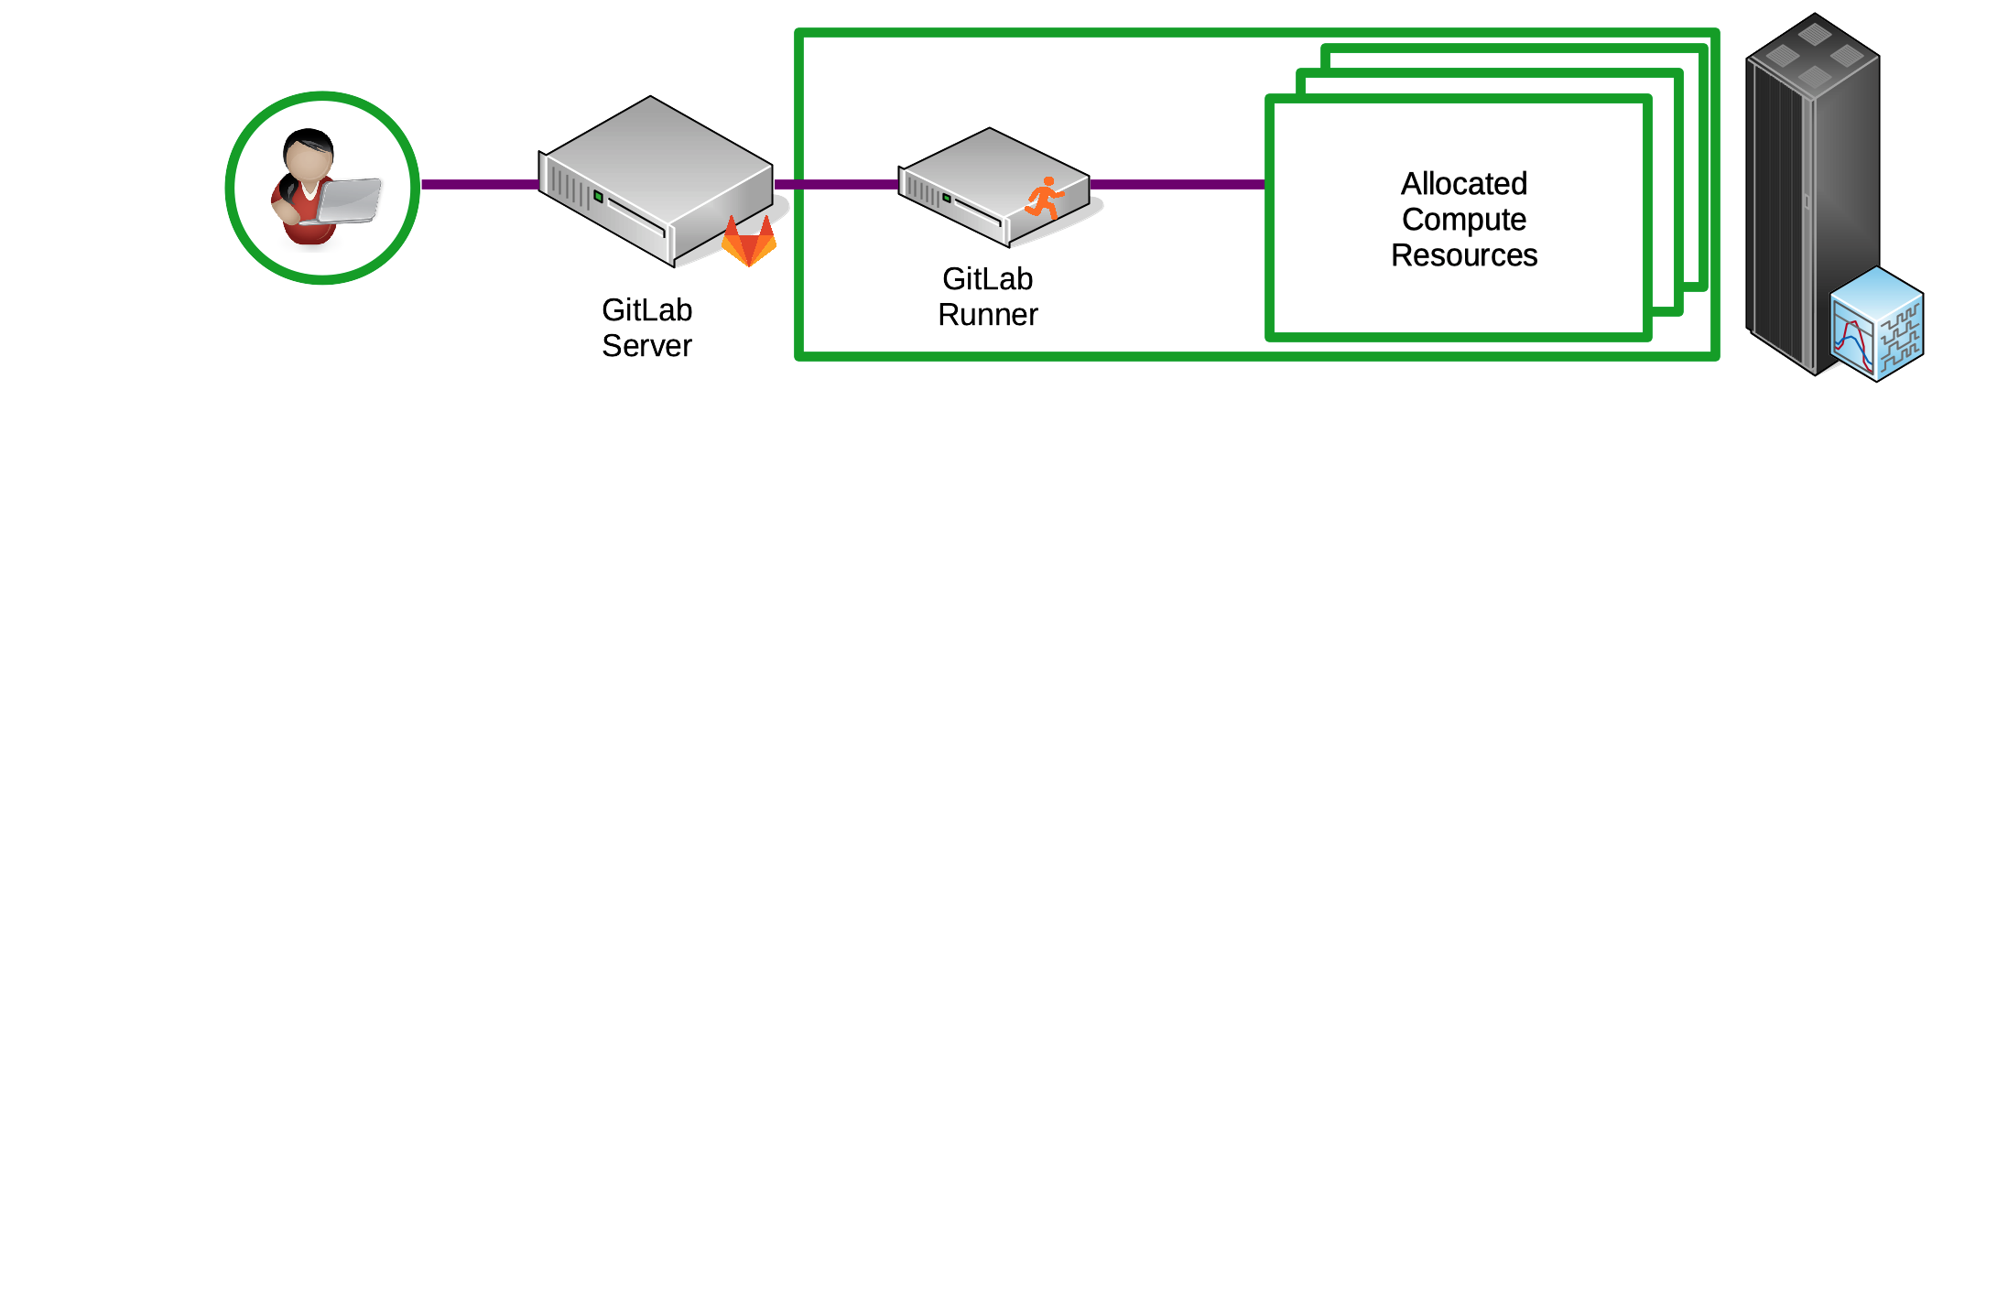
GitLab Runner
“GitLab Runner is the open source project that is used to run your CI/CD jobs and send the results back to GitLab”
Using GitLab CI/CD requires management of a runner:
Application supports the execution and reporting of CI jobs on target systems
Installed on target test resources and registered to a GitLab instance
Responsible for the execution of scripts whose creation is dictated by both the user’s CI file as well as administrative configuration

Slide 14
Our Vision
Delivering a secure, easy-to-use CI solution to support Software Product testing against E6 HPC environments.

Slide 15
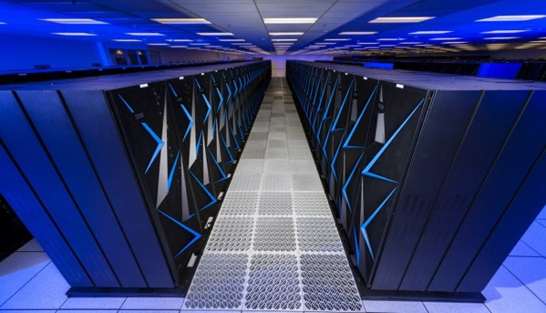
Security Challenges and Use Cases
All GitLab CI jobs run as the single gitlab-runner user
Achieving any level of isolation between CI jobs requires either:
1) Targeting specific runners such as Docker or Virtual machines
2) Having each user/team manage their own runner
Neither of these are ideal
Use cases we aim to support
Runner data isolation
Account specific resources
Sensitive data sets
Administrator management

Slide 16
Enhanced GitLab Functionality
Developing and supporting enhancements to GitLab applications to ensure targeted HPC testing resources can be available to code teams
Integrating facility feedback to improve technical aspects and support logistical challenges.
Runner capable of setuid, enforcing local permissions
Jobs are executed under a users local account
Batch executor added to interface with Cobalt, LSF, and Slurm
A runner side configuration that dictates how a CI job will be executed.
Federated cross site continuous integration
Previously auth endpoints only used at login, now they have been expanded and integrated into the CI process as well.
Existing GitLab functionality will continue to be supported
For instance continued upstream development efforts and improved to GitLab’s core CI/CD capabilities can be used for

Slide 17
What is the GitLab Runner Doing?
The GitLab runner polls the server to identify available CI jobs
Will only begin executing a job once it has been scheduled by the server
Job local to runner result in generated Bash scripts based upon the contents of the .gitlab-ci.yml
Works similar to upstream GitLab (https://docs.gitlab.com/runner/shells/index.html)
Scripts are executed by piping them into a non-interactive Bash login shell.
Every step in a CI job is executed by a valid local user account
This is a key change with setuid enabled runner
Each user is provided with a clean login shell
Ensures runner environment does not compromise subsequent jobs
Users experience an environment similar to what they would see on a login node
Depending on your environment this may affect the results of your CI

Slide 18
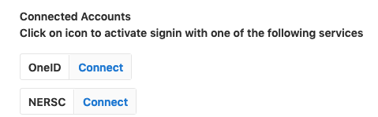
Federation
Goal of allowing cross site CI in a secure manner while still empowering site admins with the tools to ensure policy is enforced.
Site Identify Providers are used and also linked to specific runners
Valid site credentials must be present before a job could be run at any specific site.
Enhanced identity model that establishes a connection between a site runner, auth provider, and the user’s session.
Gitlab Omniauth as a first class citizen:
“...Users can choose to sign in using any of the configured mechanisms.”
I.e. LDAP and standard Gitlab login can still function, but many providers can be added
Ongoing communication directly with GitLab to upstream enhancements.

Slide 19
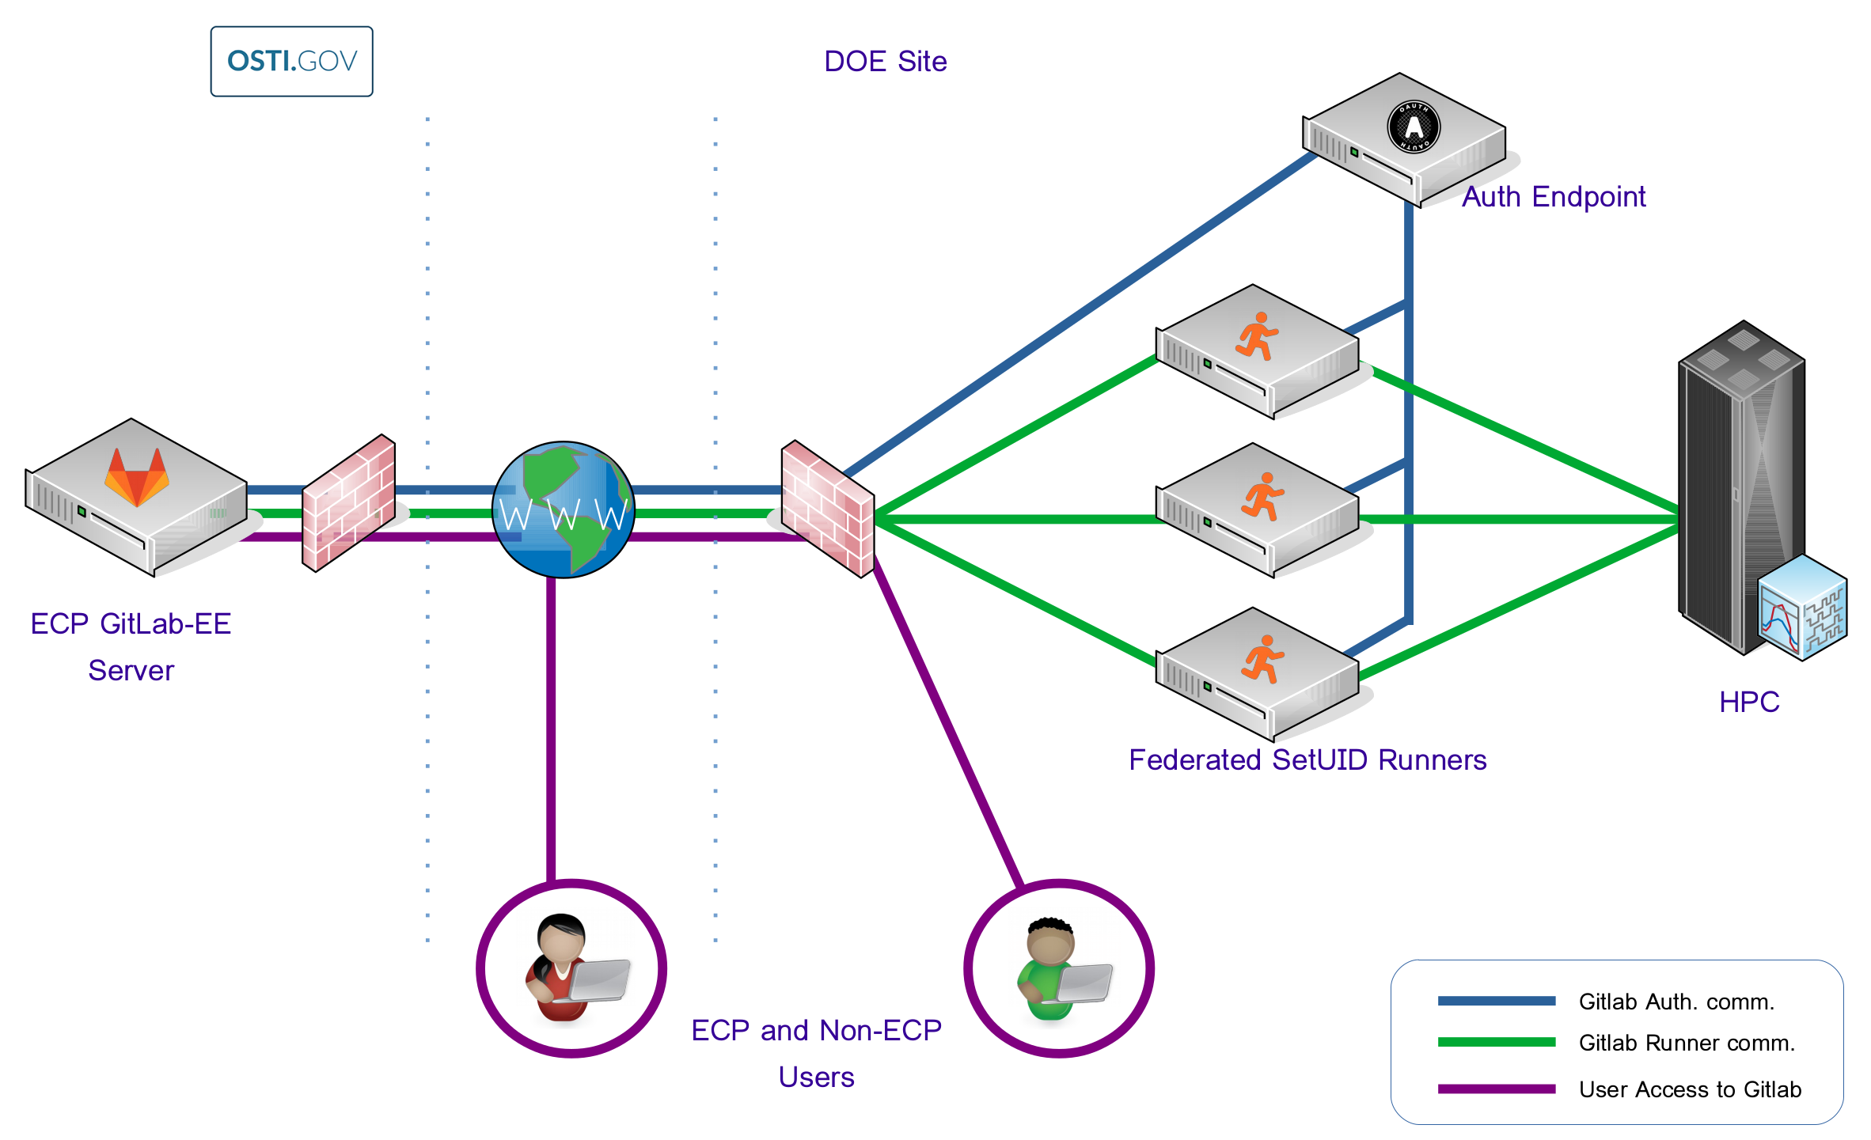
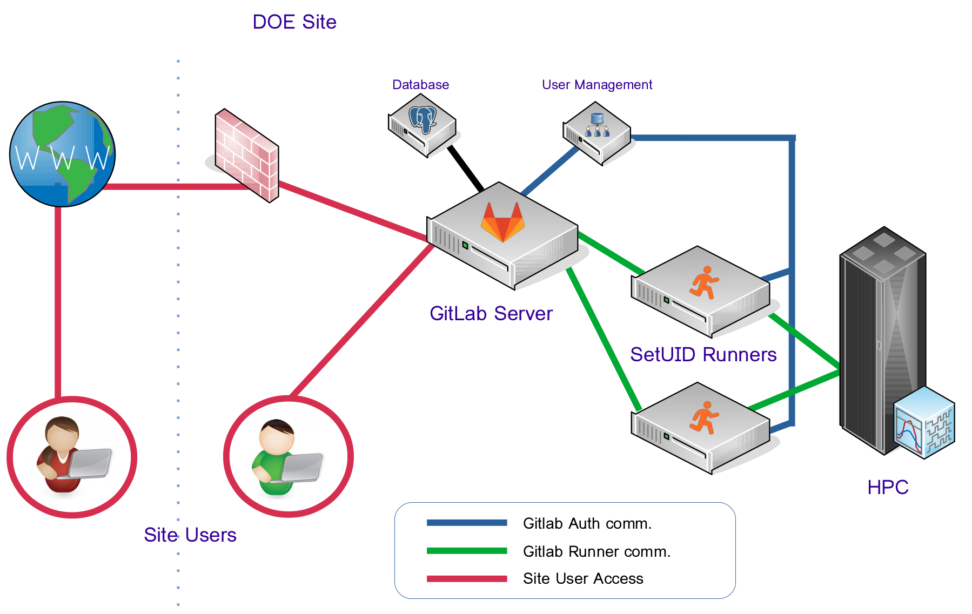
Deployment Models
Federated - Centralized (OSTI) Sever
Site - Local Site Server
Single, centrally managed Gitlab Server instance provided and administered by the OSTI team.
Federated runners at sites
Multi-site run capabilities
Separate and isolated Gitlab Server provided and administered by the site’s Operations team.
Local systems/resources capacity

Slide 20
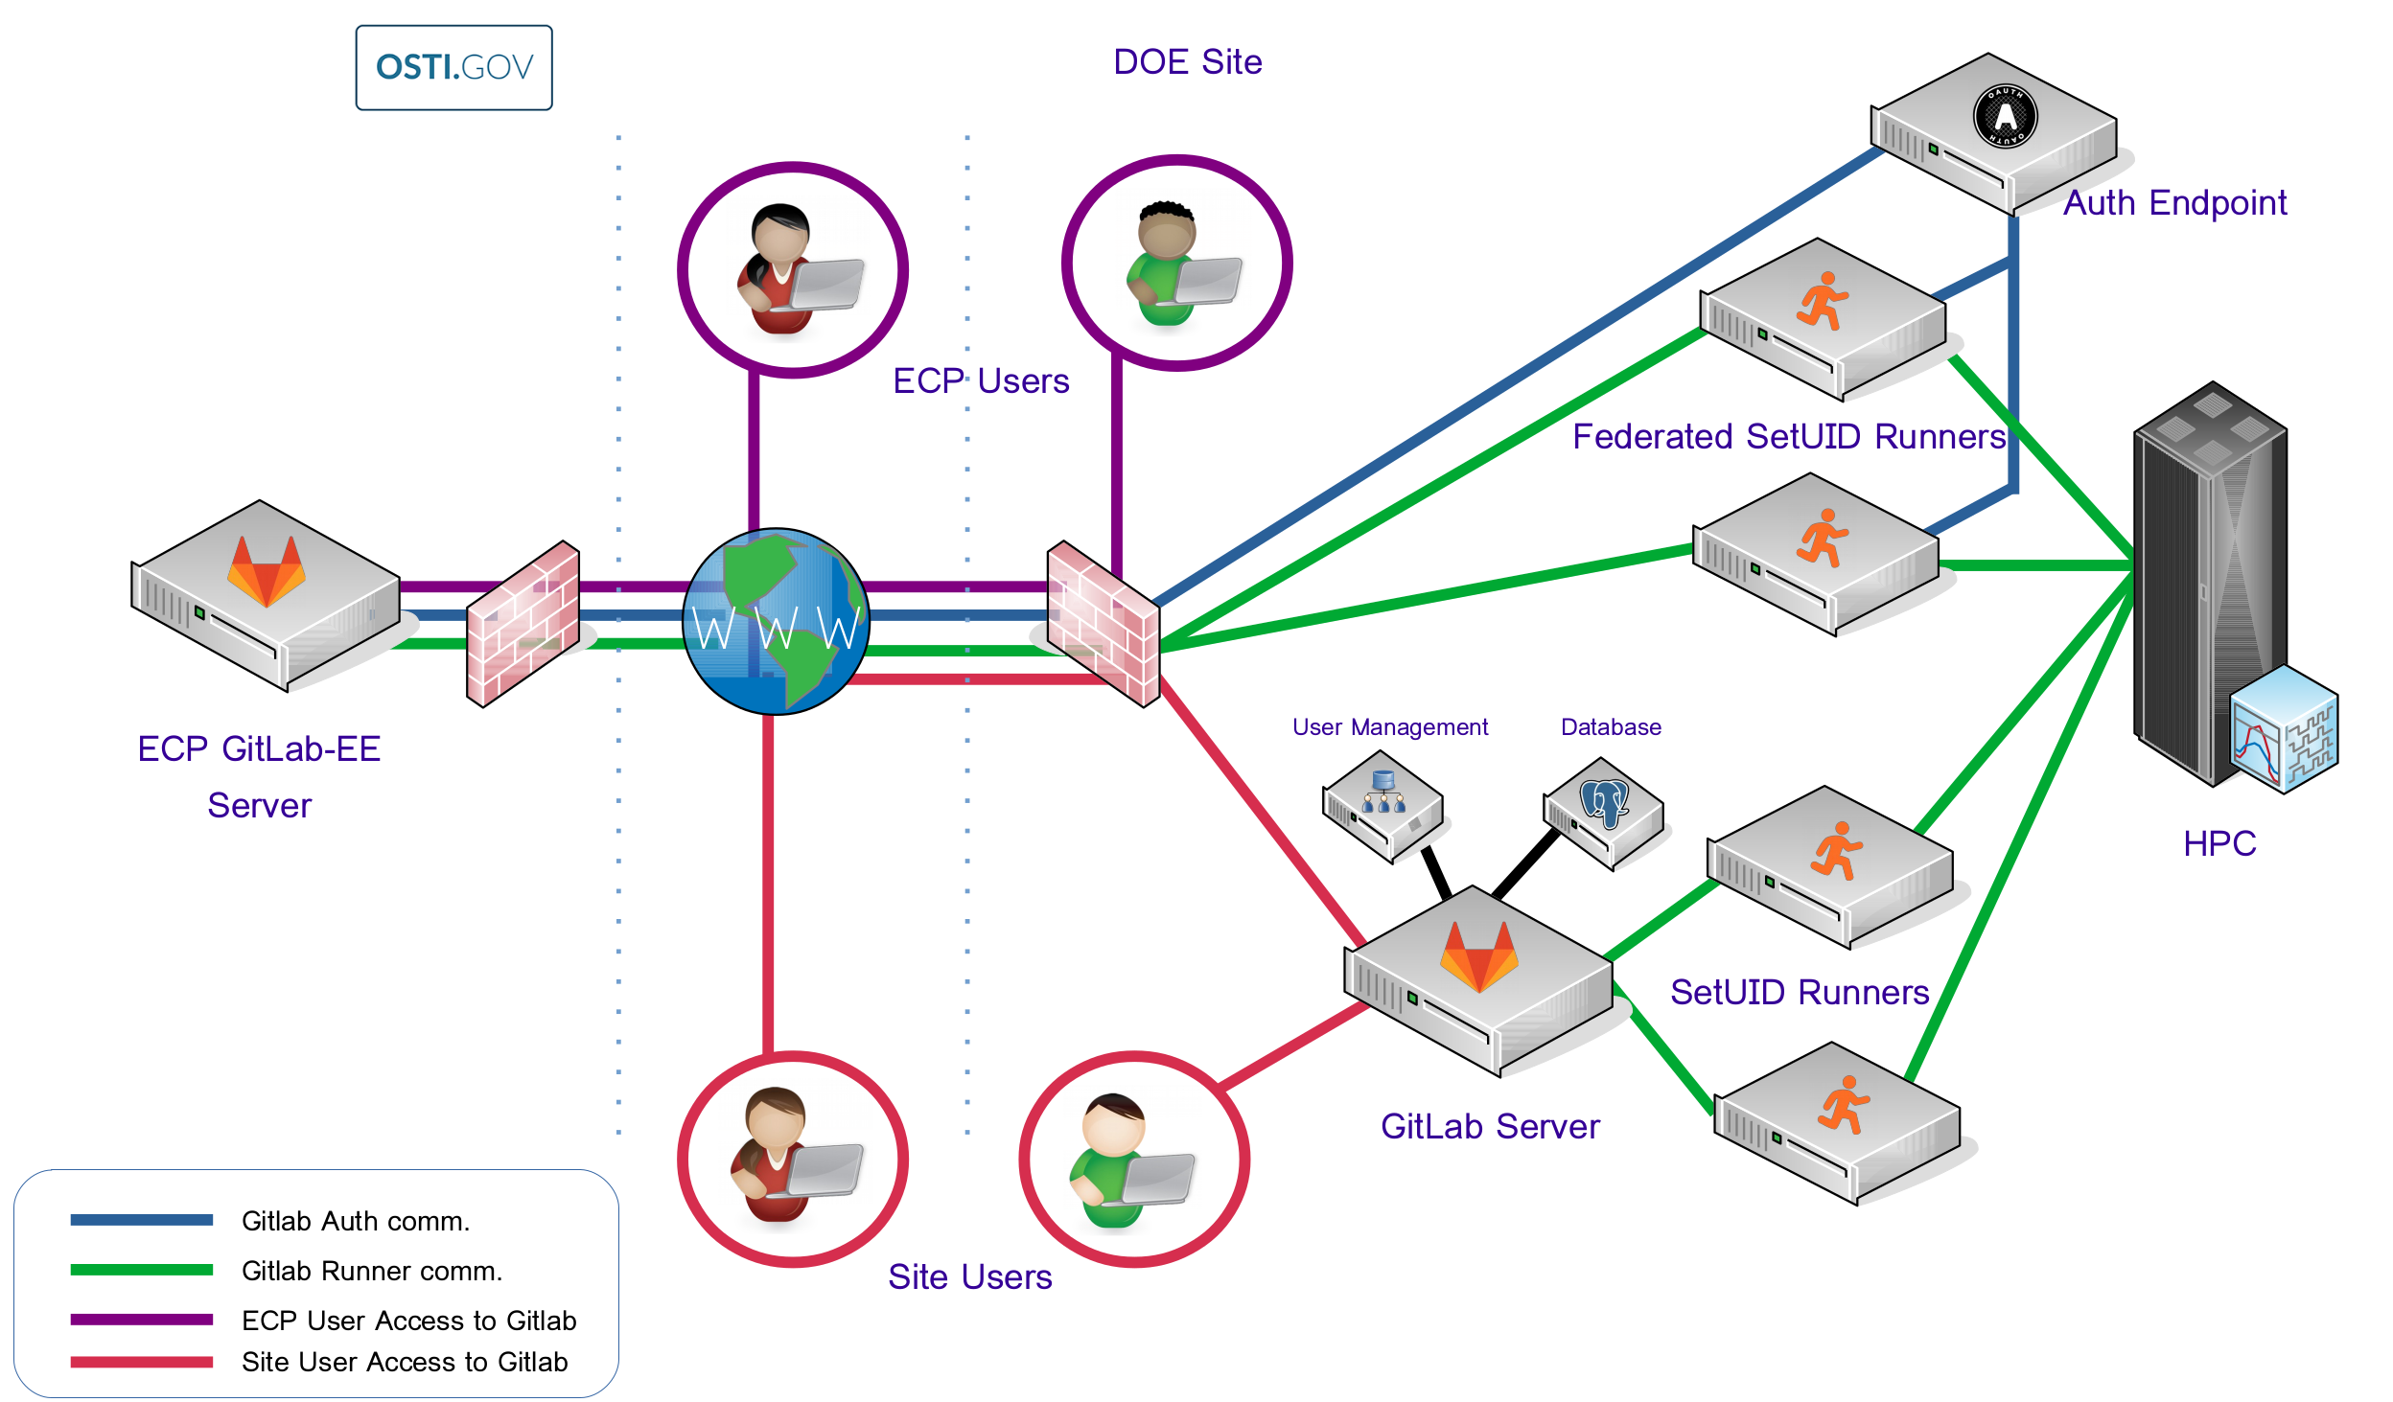
Deployment Models - Contd.
Deployment Models - Contd.
Federated with Site Local - Hybrid
Most likely to be the typical deployment model for DOE facilities
Federated capabilities
Control over Site deployment

Slide 21
CI Testing Tier - HPC Resources
Testing Tier | Description | Notes
Tier 0 | What AD/ST projects do now Existing CI | May include GitHub/Travis, existing internal systems, cron jobs, etc...
Tier 1 | Base ECP CI - Build and Run resources Possible 2 build and 2 run nodes Build and Smoke tests Run multiple builds on resource Unit / Integration tests Cross-site CI target | What is ratio of build to test resources? Work with AD and ST teams to support their needs Possible to allocate from other HPC resources with separate scheduling policy
Tier 2 | Facility test resource (~10 + nodes) In security enclave – site dependent Larger scale tests Facility approval for projects | Facility managed and may want to approve projects Possible production security constraints
Tier 3 | Production machines Need allocation Production job rules Scale tests | Facility managed and may want to approve projects Production security constraints
CI
Cross-Site
Targeting
CI
Cross-Site
Facilitating

Slide 22
CI Testing Tier - HPC Resources
Testing Tier | Description | Notes
Tier 0 | What AD/ST projects do now Existing CI Regression tests (no CI) | May include GitHub/ Travis - internet cron job based regression on misc. hardware
Tier 1 | Base ECP CI - Build and Run resources Possible 2 build and 2 run nodes Build and Smoke tests Run multiple builds on resource Unit / Integration tests Cross-site CI target | What is ratio of build to test resources? Work with AD and ST teams to support their needs Possible to allocate from other HPC resources with separate scheduling policy
Tier 2 | Facility test resource (~10 + nodes) In security enclave – site dependent Larger scale tests Facility approval for projects | Facility managed and may want to approve projects Possible production security constraints
Tier 3 | Production machines Need allocation Production job rules Scale tests | Facility managed and may want to approve projects Production security constraints
CI
Cross-Site
Targeting
CI
Cross-Site
Facilitating

Slide 23
CI Readiness
Site readiness for OSTI hosted CI with federated runners
 | Local CI | MOU | Auth Endpoint | Federated(OSTI) CI
ORNL | Available | In-process | In-process: 2/2020
NERSC | Available | In-process | Complete | In-process
ANL | Available | In-process | In-process: 2/2020
LANL | Available | In-process | In-process
LLNL | Available | In-process | In-process
SNL | Available | In-process | In-process
NMC |  | In-process | In-process: 1/2020 | Complete

Slide 24
What’s available and Where?
ANL
Local Gitlab CE Server with ECP enhanced runners
Integration with Iota(test) and Theta HPC systems
ORNL
Local Gitlab EE Server with ECP enhanced runners
Integration with Ascent(test) HPC system
NERSC
Local Gitlab EE Server with ECP enhanced runners
Integration with Cori HPC system
Other
Local Gitlab CE Server with ECP enhanced runners
Integration with P9, x86, and ARM systems
Local Preview Environments
Notes:
NMC - this is an important site for the project because we can work on federation with OSTI and remote users, used for debug and POCs of multi-site CI runs

Slide 25
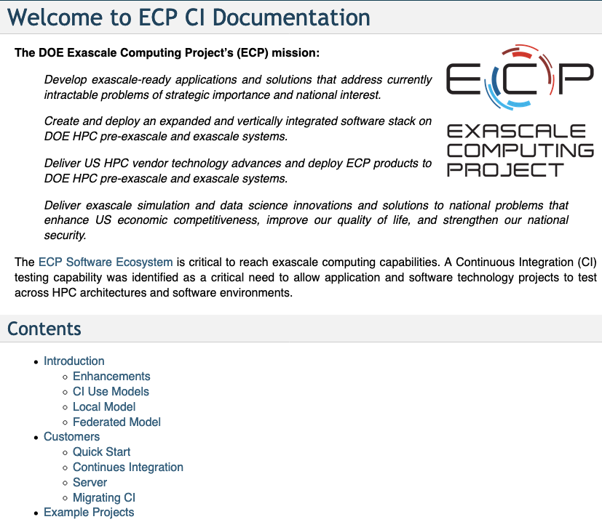
Documentation
Need to address ongoing requests for organized documentation
https://ecp-ci.gitlab.io
Using GitLab Pages
Ongoing effort to provide value up to date information
Goal is not to replace upstream documentation but highlight HPC focused enhancements and best-practices.
Site specific information organized using Confluence
https://confluence.exascaleproject.org/display/HISD/Getting+Started+with+CI

Slide 26
CI Integration and AD/ST Project Teams
Effort includes the on-boarding of ECP AD/ST and E6 software projects onto the ECP/E6 CI infrastructure.
Derives capability from the CI Optimization effort and the CI Test Resources effort. It is focused on supporting software teams and helping them port and utilize the ECP CI infrastructure.
Goals:
Helping individual teams on-board and teams
Developing documentation and training
Support development of tools to support CI teams
Identify limitations of CI infrastructure / resources and areas of potential growth
Ready to support more projects at sites in a preview environment
We want to help teams to get running locally at the sites
Assist in transition to the OSTI model down the road, if desired

Slide 27
Additional IDEAS Activities at the ECP 4AM
Day | Time | Room | Event Title
Tuesday | 10:30am-12:00pm | Founders II | Breakout: Collaboration Opportunities with the BSSw Fellows
Tuesday | 10:30am-12:00pm | Founders III | BOF: Cultivating Software Sustainability and Productivity through BSSw.io
Tuesday | 2:30pm-3:30pm | Founders I | Breakout: The Scope and Role of DevOps in HPC
Wednesday | 2:30pm-4:00pm | Founders I | Breakout: Hands-on with Progress Tracking Cards: A Lightweight Method for Improving Your Software Practices
Thursday | 1:30pm-4:30pm | Champions I | Breakout: Developing Engaged and Productive Virtual Teams
Tuesday-Thursday |  | Discovery B | Poster #77: Rate Your Project’s Software Practices!
Tuesday-Thursday |  | Discovery B | Poster #78: Lightweight Software Quality Practice — PSIP: Productivity and Sustainability Improvement Planning
Tuesday-Thursday |  | Discovery B | Poster #114: Better Scientific Software: So Your Code Will See the Future
Tuesday-Thursday |  | Discovery B | Poster #115: IDEAS-ECP: Advancing Software Productivity for Exascale Applications
Tuesday-Thursday |  | Meeting Lobby | IDEAS Desk: Let’s talk about software (available during all breaks and selected poster and breakout slots)

Slide 28
Backup: CI Hello World
Simplest CI example
https://github.com/jrdoneal/CI_HelloWorld
https://travis-ci.org/jrdoneal/CI_HelloWorld
CI example w/ multiple platforms and specific compiler versions
https://github.com/jrdoneal/CI_Multiplatform
Code coverage, testing and CI tutorial (C++)
https://github.com/amklinv/morpheus
Code coverage, testing, and CI example (Fortran, C++)
https://github.com/jrdoneal/infrastructure

Slide 29
GitHub Repository Page
https://github.com/jrdoneal/CI_HelloWorld

Slide 30
Travis CI Configuration File
.travis.yml

Slide 31
The Script Phase
hello_world.sh

Slide 32
Connecting GitHub & Travis CI

Slide 33
Repository in Travis CI
https://travis-ci.org/jrdoneal/CI_HelloWorld

Slide 34
Commit History
.travis.yml
added

Slide 35
Travis CI Build History
Notes:
TRAVIS_CI_ENV not yet set in .travis.yml. We see that the echo is empty and that hello_world.sh caught the problem. Also Travis CI detects the correct exit code. The after_failure phase was correctly called.

Slide 36
Travis CI Build History
Notes:
TRAVIS_CI_ENV is now set in .travis.yml, which we can see in the log. Also, the echo is printing out a true statement and we see that hello_world.sh caught the problem. Also Travis CI detects the correct exit code. The after_failure phase was correctly called.

Slide 37
Travis CI Build History
!

